Slide 1

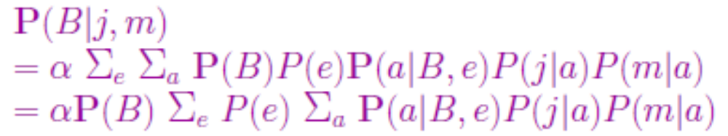
Inference in Bayesian Nets
Objective: calculate posterior prob of a variable x conditioned on evidence Y and marginalizing over Z (unobserved vars)
Exact methods:
  Enumeration
  Factoring
  Variable elimination
  Factor graphs (read 8.4.2-8.4.4 in Bishop, p. 398-411)
  Belief propagation
Approximate Methods: sampling (read Sec 14.5)

Slide 2
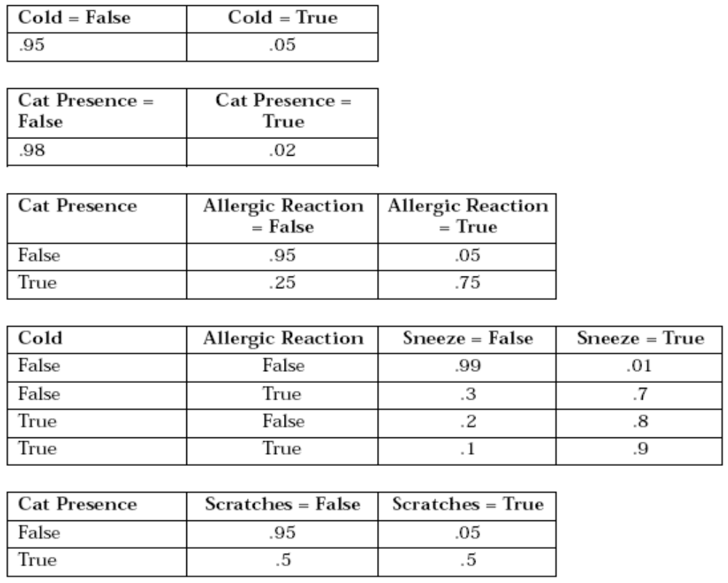
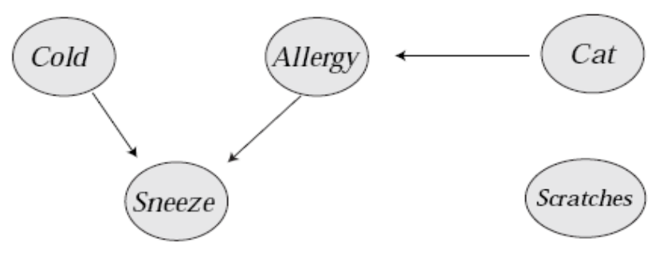
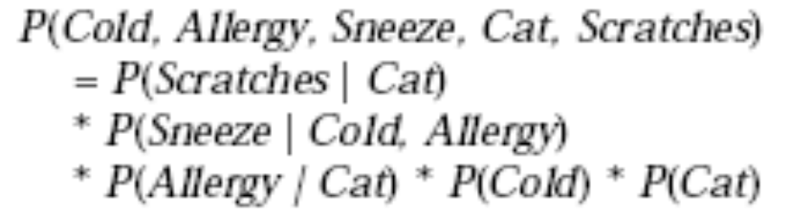
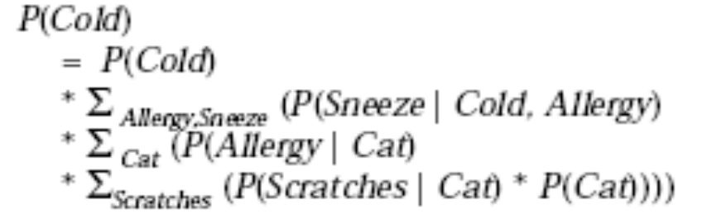
from: Inference in Bayesian Networks (D’Ambrosio, 1999)

Slide 3
Factors
A factor is a multi-dimensional table, like a CPT
f_{AJM}(B,E)
  2x2 table with a “number” for each combination of B,E
  Specific values of J and M were used
  A has been summed out
f(J,A)=P(J|A) is 2x2:
f_{J}(A)=P(j|A) is 1x2: {p(j|a),p(j|¬a)}
p(j|a) | p(j|¬a)
p(¬j|a) | p(¬j|¬a)

Slide 4
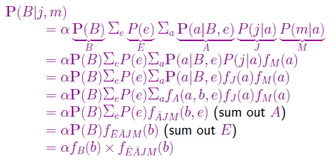
Use of factors in variable elimination:

Slide 5
Pointwise product
given 2 factors that share some variables:
  f1(X1..Xi,Y1..Yj), f2(Y1..Yj,Z1..Zk)
resulting table has dimensions of union of variables, f1*f2=F(X1..Xi,Y1..Yj,Z1..Zk)
each entry in F is a truth assignment over vars and can be computed by multiplying entries from f1 and f2
A | B | f1(A,B)
T | T | 0.3
T | F | 0.7
F | T | 0.9
F | F | 0.1
B | C | f2(B,C)
T | T | 0.2
T | F | 0.8
F | T | 0.6
F | F | 0.4
A | B | C | F(A,B,C)
T | T | T | 0.3x0.2
T | T | F | 0.3x0.8
T | F | T | 0.7x0.6
T | F | F | 0.7x0.4
F | T | T | 0.9x0.2
F | T | F | 0.9x0.8
F | F | T | 0.1x0.6
F | F | F | 0.1x0.4

Slide 6
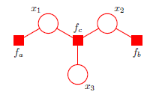
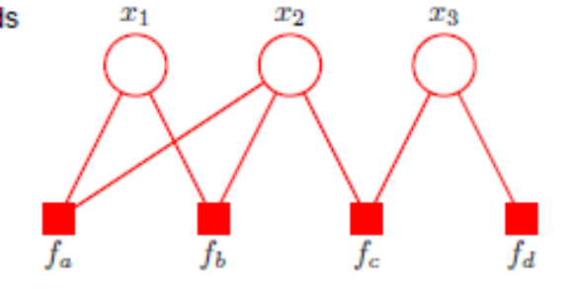

Factor Graph
Bipartite graph
  variable nodes and factor nodes
  one factor node for each factor in joint prob.
  edges connect to each var contained in each factor

Slide 7
F(B)
F(E)
B
E
F(A,B,E)
A
F(J,A)
F(M,A)
J
M

Slide 8
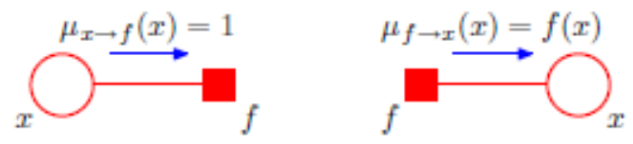
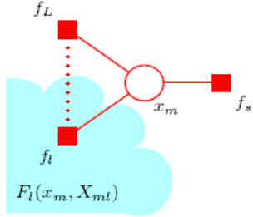

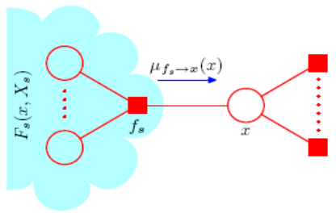

Message passing
Choose a “root” node, e.g. a variable whose marginal prob you want, p(A)
Assign values to leaves
  For variable nodes, pass μ=1
  For factor nodes, pass prior: f(X)=p(X)
Pass messages from var node v to factor u
  Product over neighboring factors
Pass messages from factor u to var node v
  sum out neighboring vars w

Slide 9
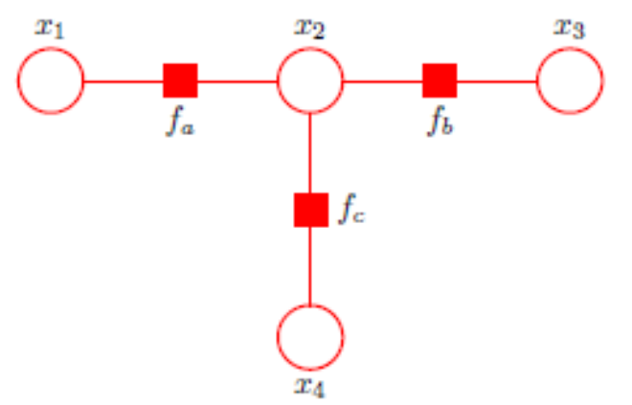
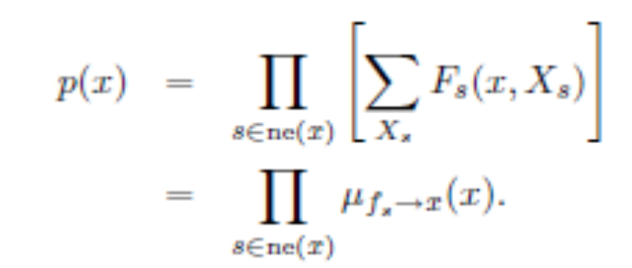
Terminate when root receives messages from all neighbors
…or continue to propagate messages all the way back to leaves
Final marginal probability of var X:
  product of messages from each neighboring factor; marginalizes out all variables in tree beyond neighbor
Conditioning on evidence:
  Remove dimension from factor (sub-table)
  F(J,A) -> F_{J}(A)

Slide 10
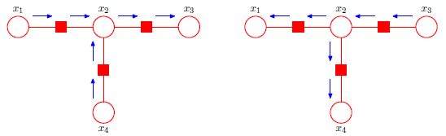
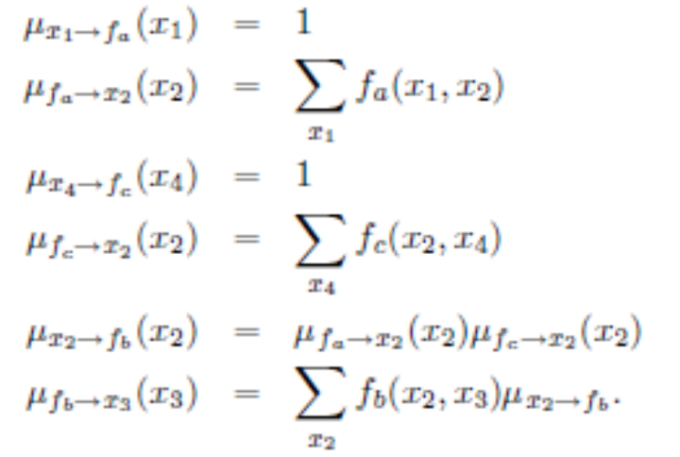
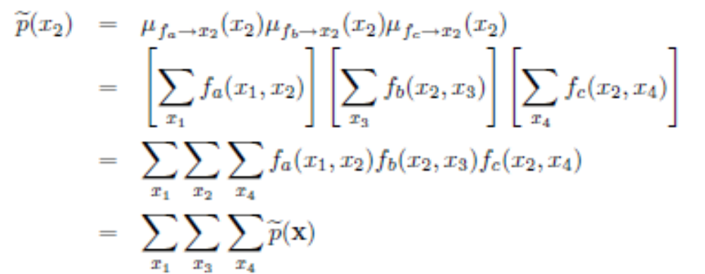

Slide 11
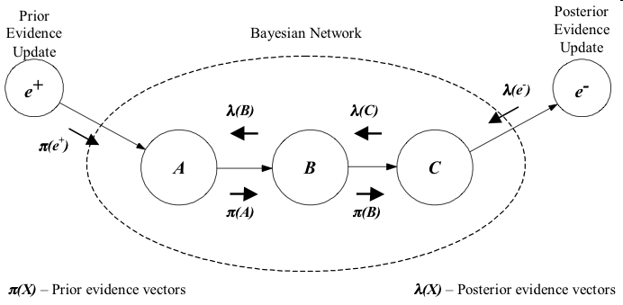
Belief Propagation
(this figure happens to come from http://www.pr-owl.org/basics/bn.php)
see also: wiki, Ch. 8 in Bishop PR&ML

Slide 12
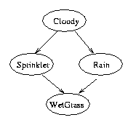
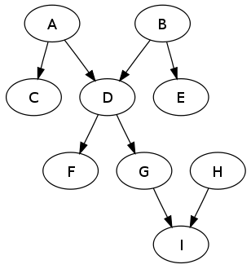
Computational Complexity
Belief propagation is linear in the size of the BN for polytrees
Belief propagation is NP-hard for trees with “cycles”

Slide 13
Inexact Inference
Sampling
  Generate a (large) set of atomic events (joint variable assignments)
    <e,b,-a,-j,m>
    <e,-b,a,-j,-m>
    <-e,b,a,j,m>
    ...
  Answer queries like P(J=t|A=f) by averaging how many times events with J=t occur among those satisfying A=f

Slide 14
Direct sampling
create an independent atomic event
  for each var in topological order, choose a value conditionally dependent on parents
    sample from p(Cloudy)=<0.5,0.5>; suppose T
    sample from p(Sprinkler|Cloudy=T)=<0.1,0.9>, suppose F
    sample from P(Rain|Cloudy=T)=<0.8,0.2>, suppose T
    sample from P(WetGrass|Sprinkler=F,Rain=T)=<0.9,0,1>, suppose T
    event: <Cloudy,¬Sprinkler,Rain,WetGrass>
repeat many times
in the limit, each event occurs with frequency proportional to its joint probability, P(Cl,Sp,Ra,Wg)= P(Cl)*P(Sp|Cl)*P(Ra|Cl)*P(Wg|Sp,Ra)
averaging: P(Ra,Cl) = Num(Ra=T&Cl=T)/|Sample|

Slide 15
Rejection sampling
to condition upon evidence variables e, average over samples that satisfy e
P(j,m|¬e,¬b)
    <e,b,-a,-j,m>
    <e,-b,a,-j,-m>
    <-e,b,a,j,m>
    <-e,-b,-a,-j,m>
    <-e,-b,a,-j,-m>
    <e,b,a,j,m>
    <-e,-b,a,j,-m>
    <e,-b,a,j,m>
    ...

Slide 16
Likelihood weighting
sampling might be inefficient if conditions are rare
P(j|e) – earthquakes only occur 0.2% of the time, so can only use ~2/1000 samples to determine frequency of JohnCalls
during sample generation, when reach an evidence variable e_{i}, force it to be known value
accumulate weight w=Π p(e_{i}|parents(e_{i}))
now every sample is useful (“consistent”)
when calculating averages over samples x, weight them: P(j|e) = αΣ_{consistent} w(x)=<Σ_{J=T} w(x), Σ_{J=F} w(x)>

Slide 17
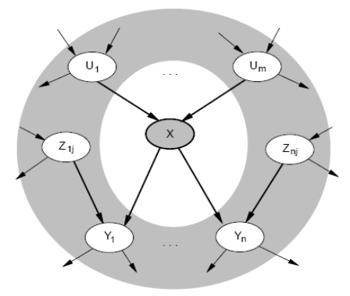
Gibbs sampling (MCMC)
start with a random assignment to vars
  set evidence vars to observed values
iterate many times...
  pick a non-evidence variable, X
  define Markov blanket of X, mb(X)
    parents, children, and parents of children
  re-sample value of X from conditional distrib.
    P(X|mb(X))=αP(X|parents(X))*Π P(y|parents(X)) for y∈children(X)
generates a large sequence of samples, where each might “flip a bit” from previous sample
in the limit, this converges to joint probability distribution (samples occur for frequency proportional to joint PDF)

Slide 18
Other types of graphical models
  Hidden Markov models
  Gaussian-linear models
  Dynamic Bayesian networks
Learning Bayesian networks
  known topology: parameter estimation from data
  structure learning: topology that best fits the data
Software
  BUGS
  Microsoft

